Slide 1
Research Question
Does WIMD adequately capture rural deprivation
in Wales, and what does that mean for rural-proofing policy?
Anisha Bhattarai
MSc Health Data Science,
University of Aberdeen
Rural Health Compass Placement

Slide 2
1,917 Welsh LSOAs, compared on eight WIMD domains
WIMD 2025 Ranks & Scores · Deep-Rooted Deprivation (2005–2025) · ONS Rural-Urban Classification 2021
561 rural LSOAs vs 1,356 urban LSOAs, joined on LSOA code
Mann-Whitney U tests, effect sizes, and Spearman correlation for rural-urban comparisons
Four analysis stages: domain comparison → 20-year tracking → domain-weight gap → local authority case studies

Slide 3
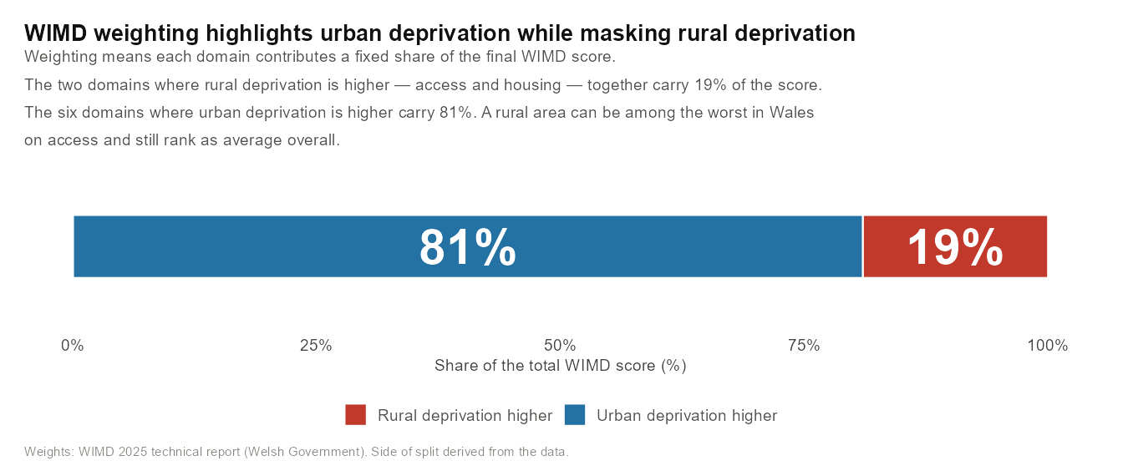

Slide 4
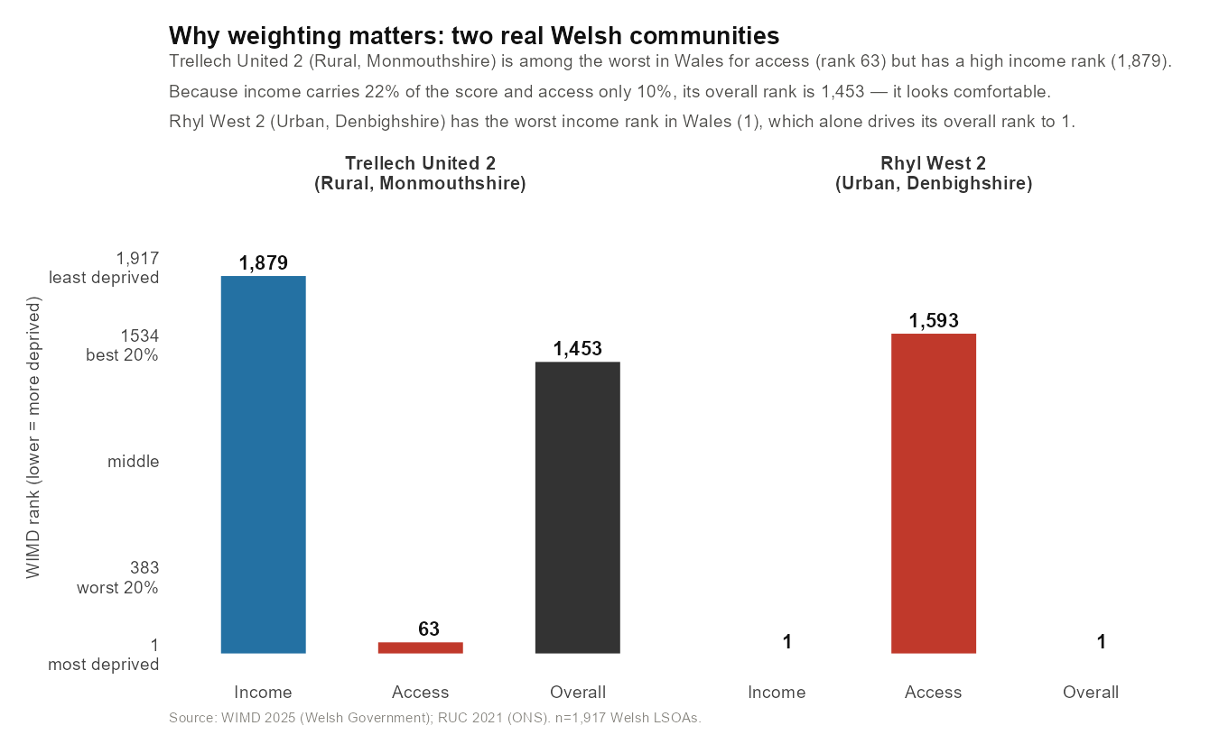
Two real Welsh communities — same overall rank, opposite deprivations

Slide 5
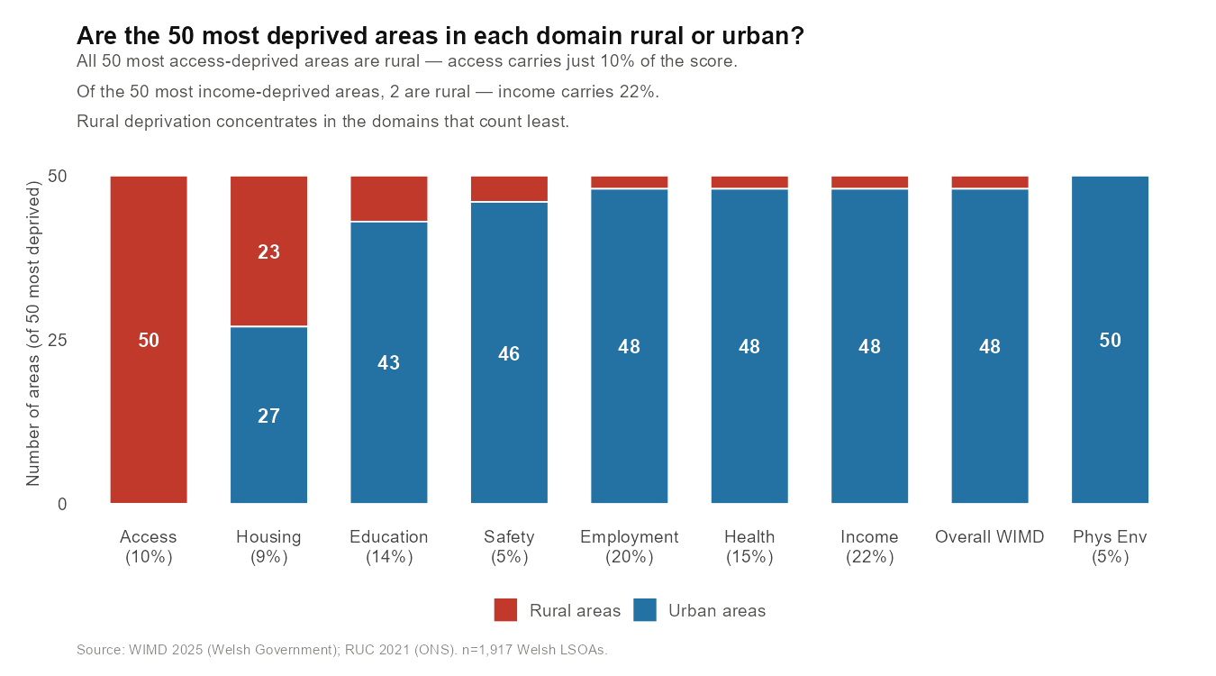
Rural areas dominate the access domain. Urban areas dominate income.

Slide 6
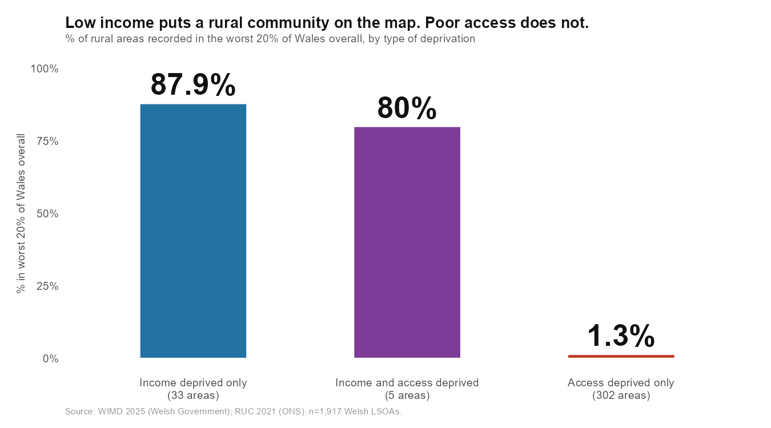

Slide 7
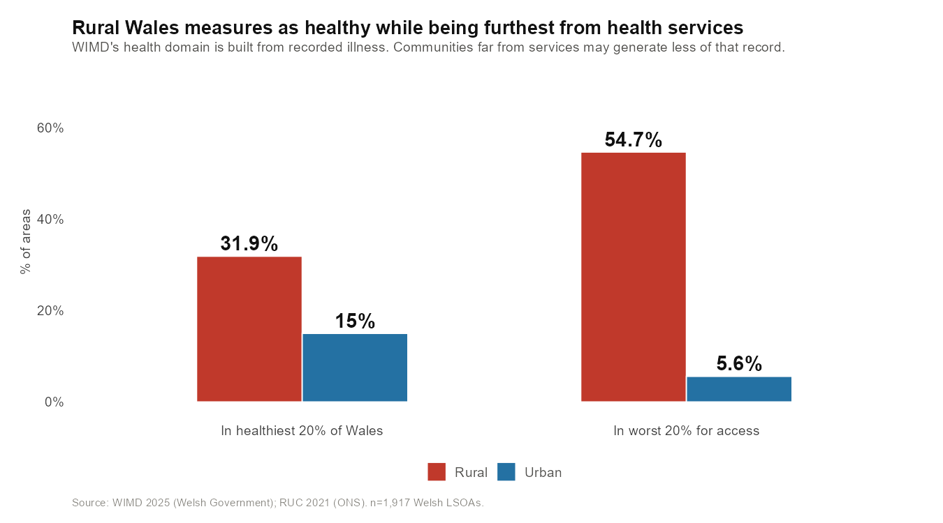

Slide 8
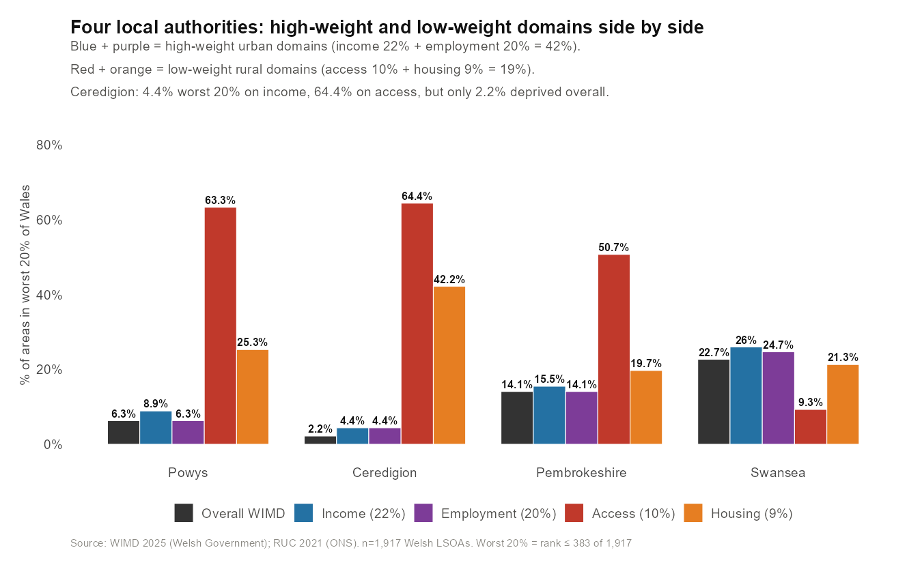
Seen in real local authorities: Ceredigion and Powys

Slide 9
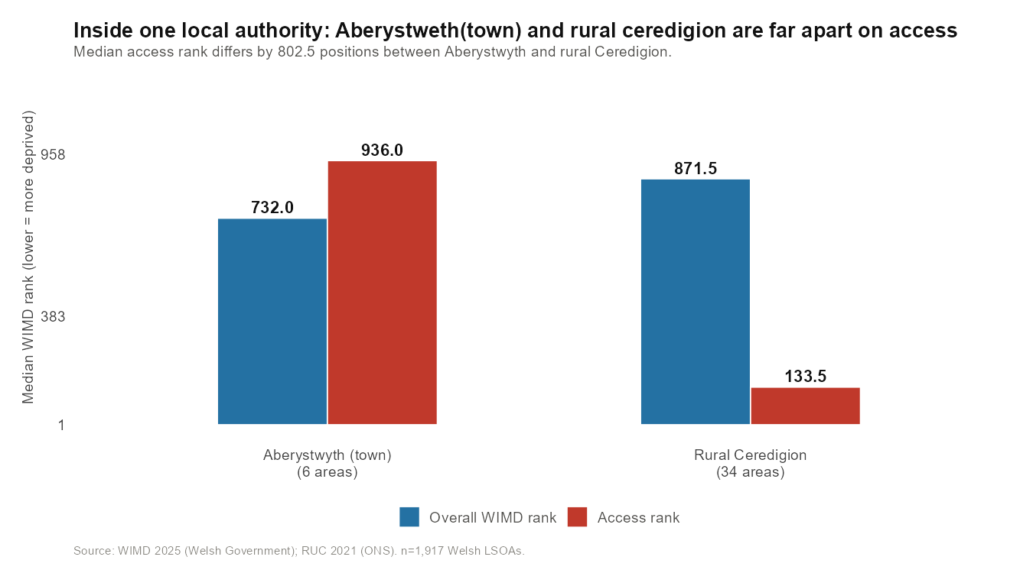

Slide 10
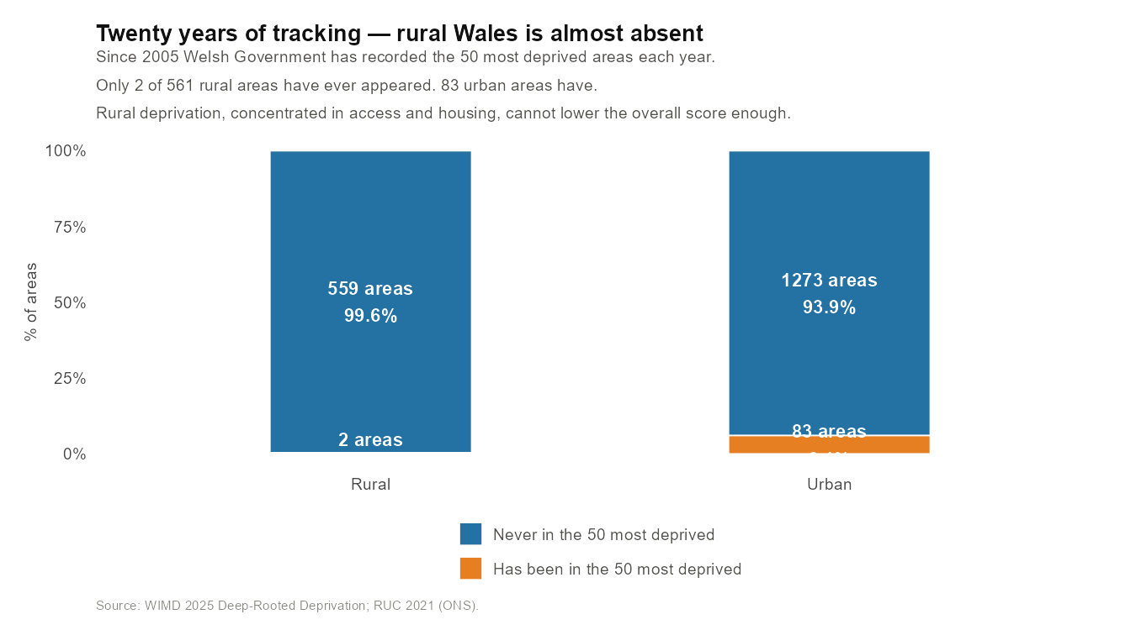

Slide 11
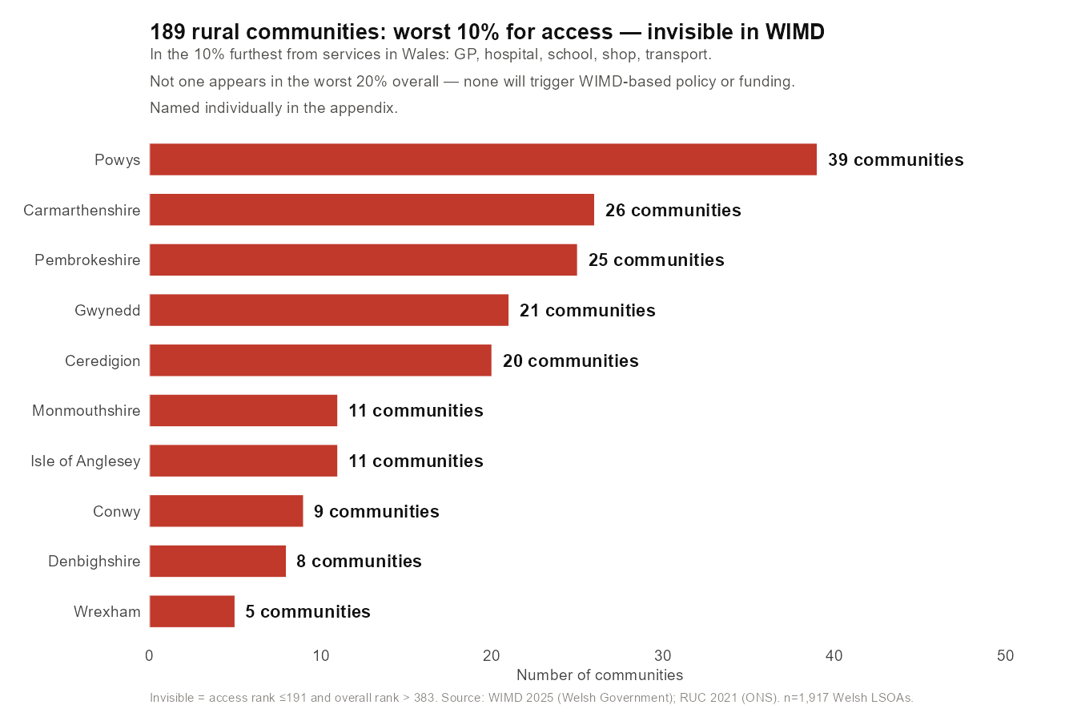

Slide 12
Thank you

